Slide 1
Fire and Smoke Detection Using Multimodal Fusion with Explainability
Final Year Capstone Project - Review 1 Guide – Dr. Geetha S.
Bhavya Chanana – 21BCE1414
Atharva Bodke – 21BAI1855

Slide 2
Project Overview
Approach: Use a CNN-Transformer fusion model with explainability.
Output: Fire/smoke probability with region-specific explanations.

Slide 3
Datasets Used
• Sentinel-2: 13 spectral bands (SWIR, NIR, Red Edge) for satellite imagery.
• ERA5: Weather data (temperature, wind speed, humidity).
• LANDFIRE: Terrain & vegetation data (elevation, fuel type, canopy cover).
• MODIS & VIIRS: Fire labels from thermal anomaly detections.

Slide 4
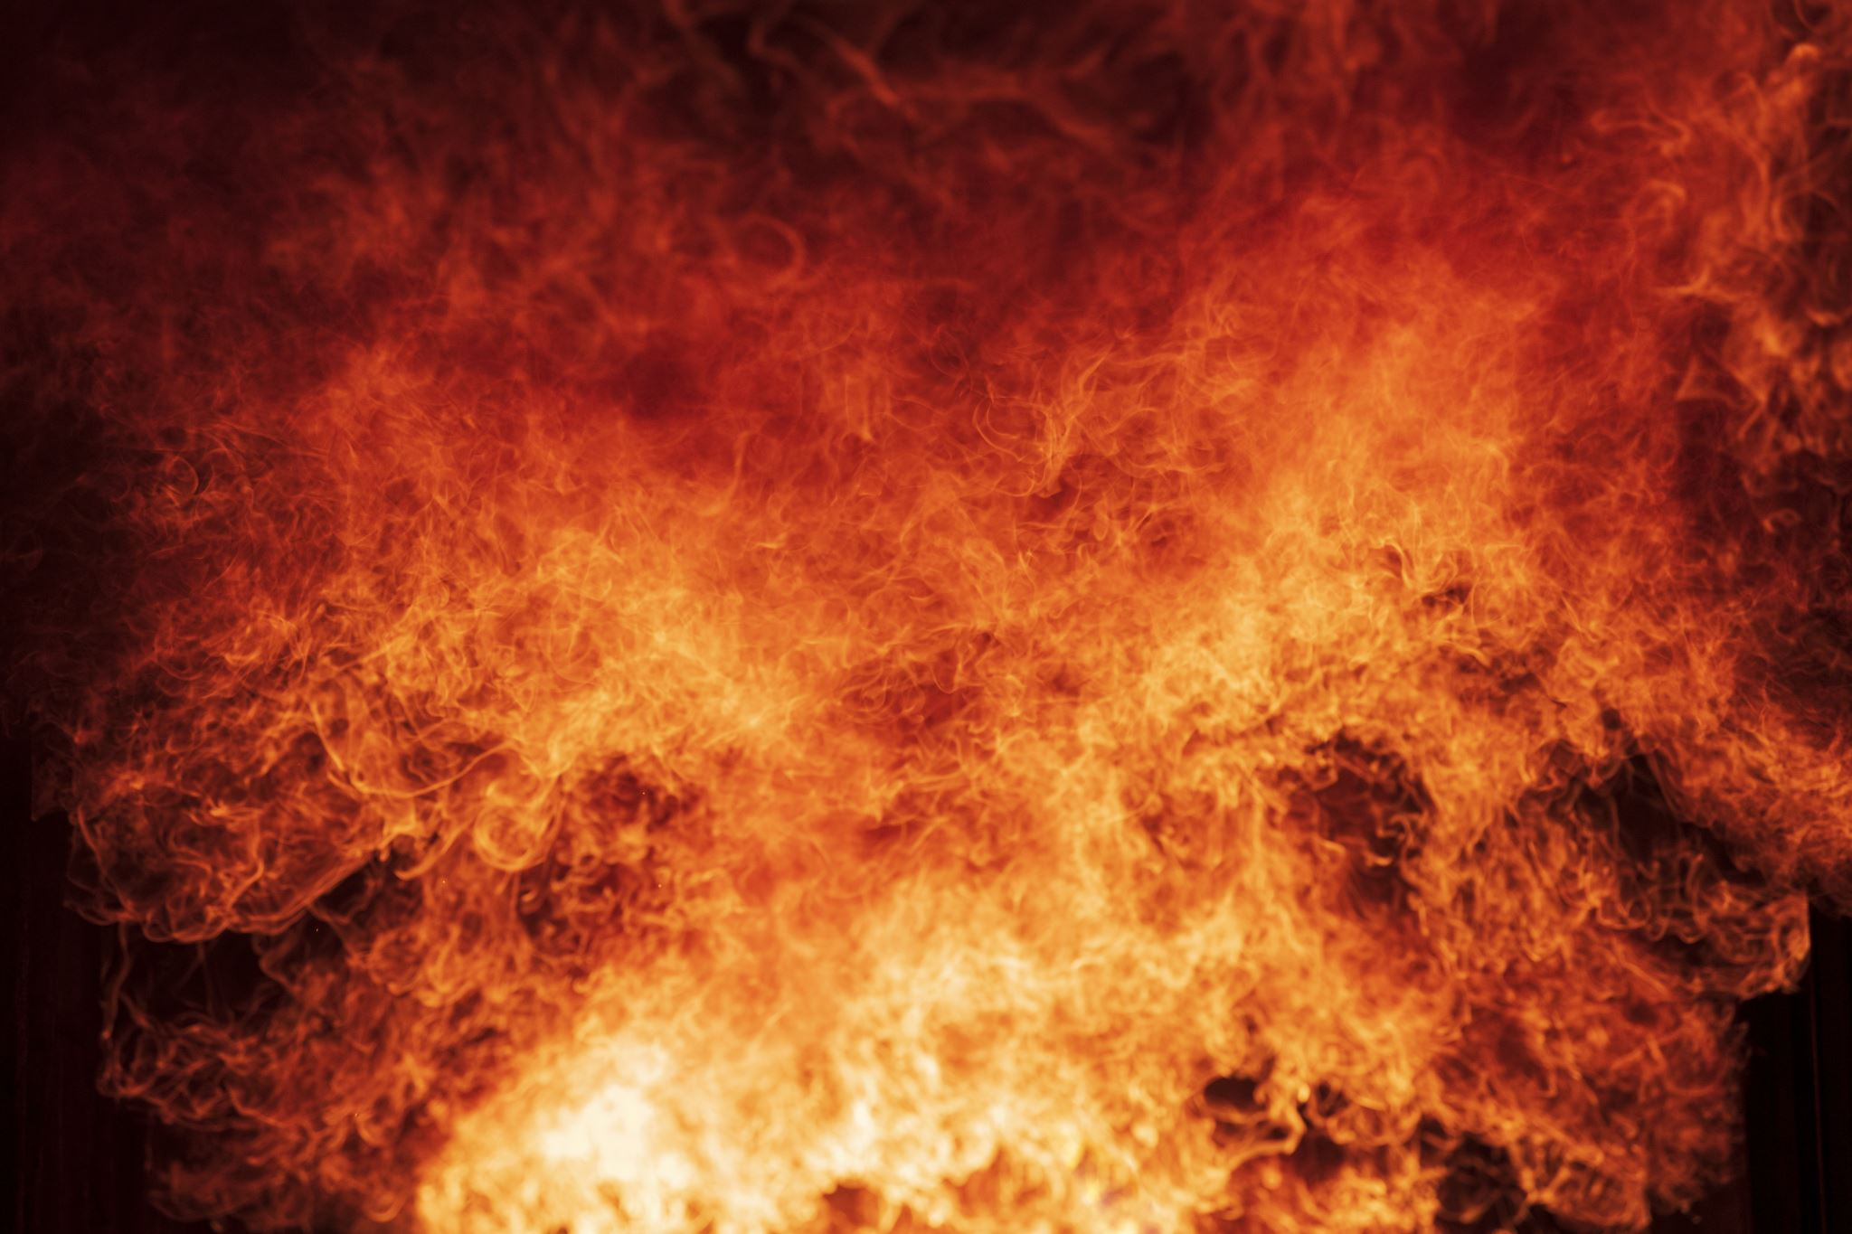
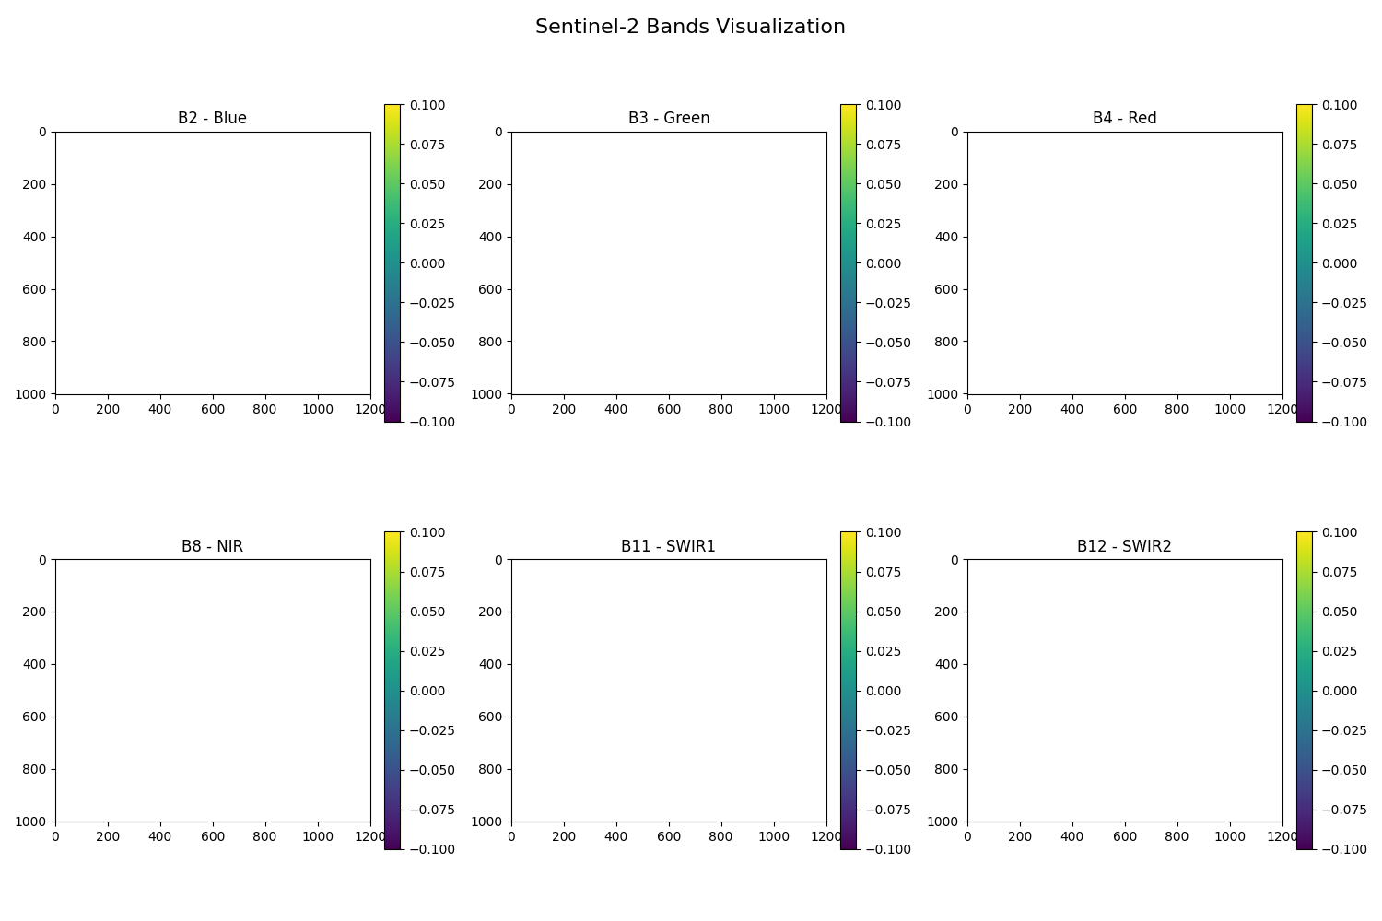
Sentinel-2: Satellite Imagery
13 spectral bands with 10m–60m resolution.
SWIR and NIR bands crucial for fire detection.
Available from Google Earth Engine (GEE).
False-Color Fire Visualization (SWIR2, SWIR1, Red): Uses infrared bands to highlight fire-affected areas, making active fires and burned regions clearly visible
Burn Severity Calculation (NBR - Normalized Burn Ratio): Compares Near Infrared (NIR) and Shortwave Infrared (SWIR2) to measure fire impact, with a color-coded map indicating burn severity.

Slide 6
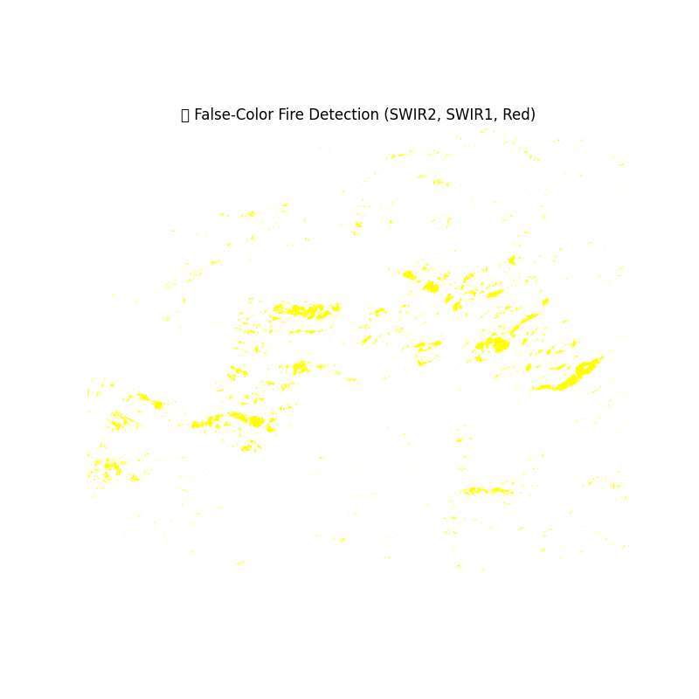
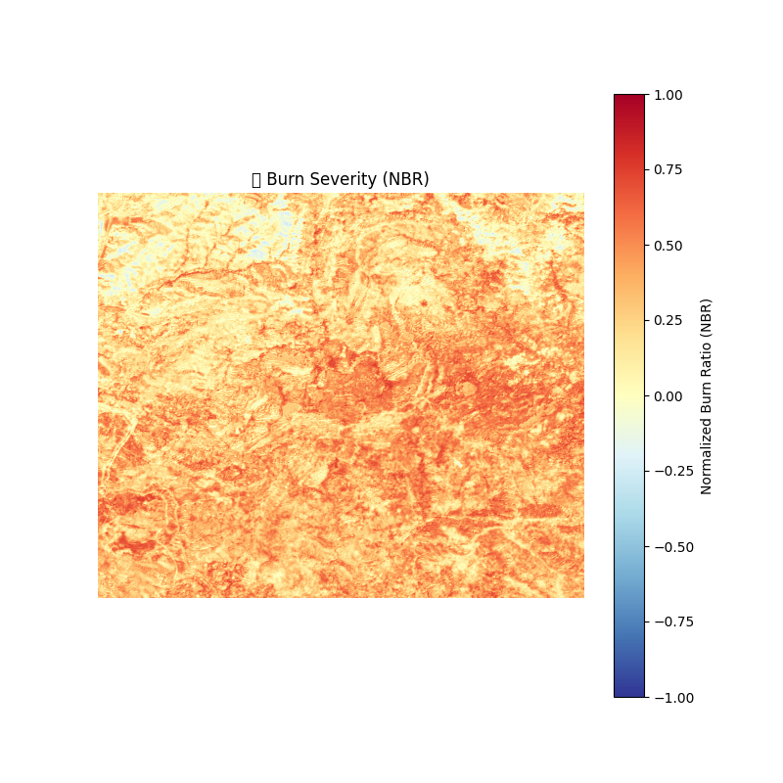
False-Color Fire Visualization and Burn Severity Calculation

Slide 7
ERA5: Weather Data
Provides hourly global weather data from 1940–present.
Key variables: temperature, humidity, wind speed.
Retrieved from Copernicus Climate Data Store (CDS).

Slide 8
LANDFIRE: Terrain & Vegetation Data
Provides elevation, slope, fuel type, and canopy cover.
Helps understand fire spread based on topography.
Downloaded as GeoTIFFs for analysis.

Slide 9
MODIS & VIIRS: Fire Labels
MODIS: 1km resolution, available since 2000.
VIIRS: 375m resolution, available since 2012.
Used as ground truth for training.

Slide 10
Data Pipeline Overview
1. Download fire labels from MODIS/VIIRS.
2. Align with Sentinel-2, ERA5, and LANDFIRE data.
3. Create fire and non-fire training samples.
4. Store in structured formats for ML training.

Slide 11
Fetching Fire Labels
Use Google Earth Engine (GEE) API to download fire locations.
Filter by region and date to match Sentinel-2 coverage.
Export as CSV for further processing.

Slide 12
Matching Fire Labels with Satellite Data
Extract spectral features from Sentinel-2 images.
Match fire locations with weather (ERA5) and terrain (LANDFIRE).
Create labeled dataset for training.

Slide 13
Data Storage Format
• Fire data stored as CSV (structured tabular data).
• Satellite images stored as GeoTIFF (for CNNs).
• Final dataset contains fire/non-fire labels with features.

Slide 14
Model Architecture Overview
• Satellite Encoder: MobileNetV3 for multispectral features.
• Weather/Terrain Encoder: Transformer/MLP for tabular data.
• Cross-Modal Fusion: Transformer-based attention mechanism.

Slide 15
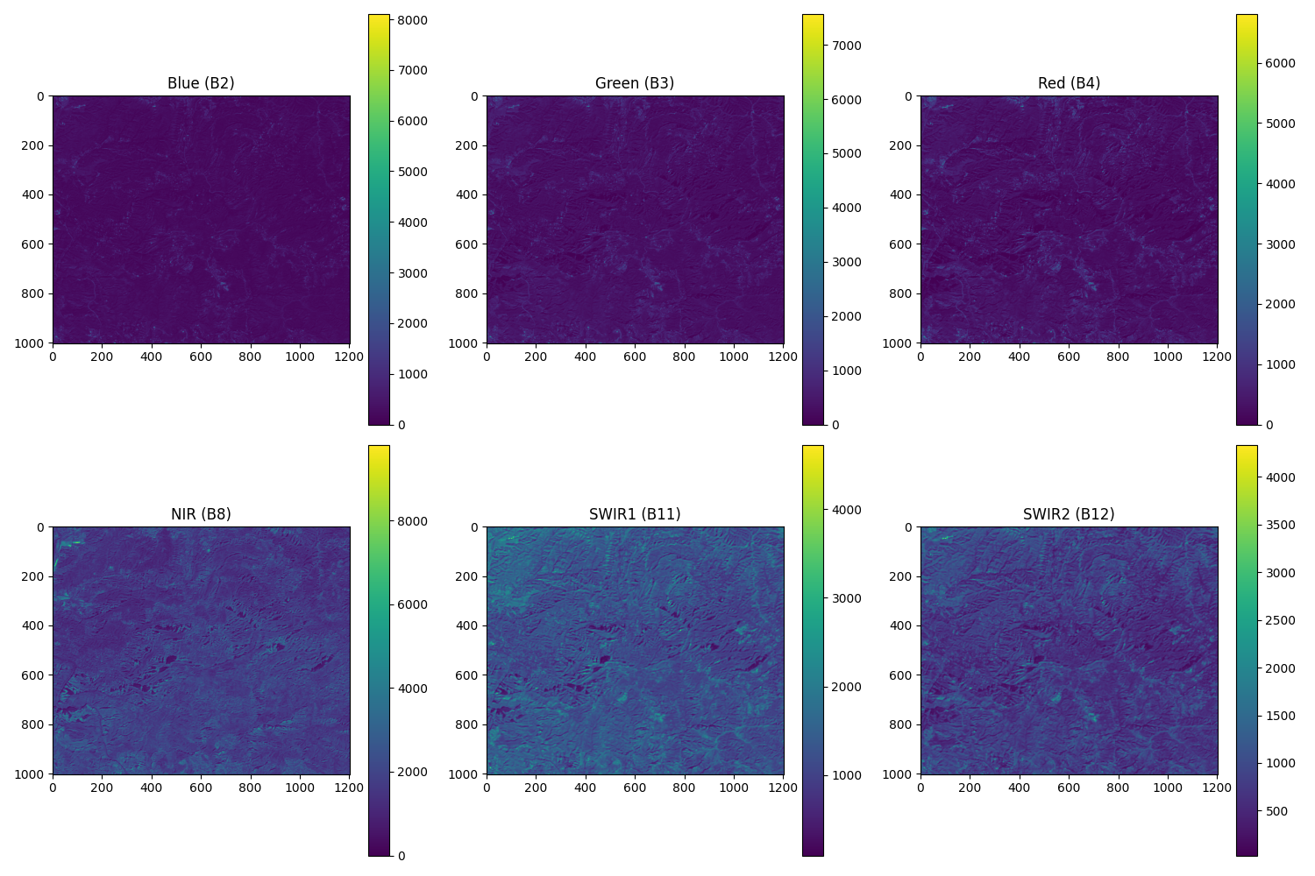
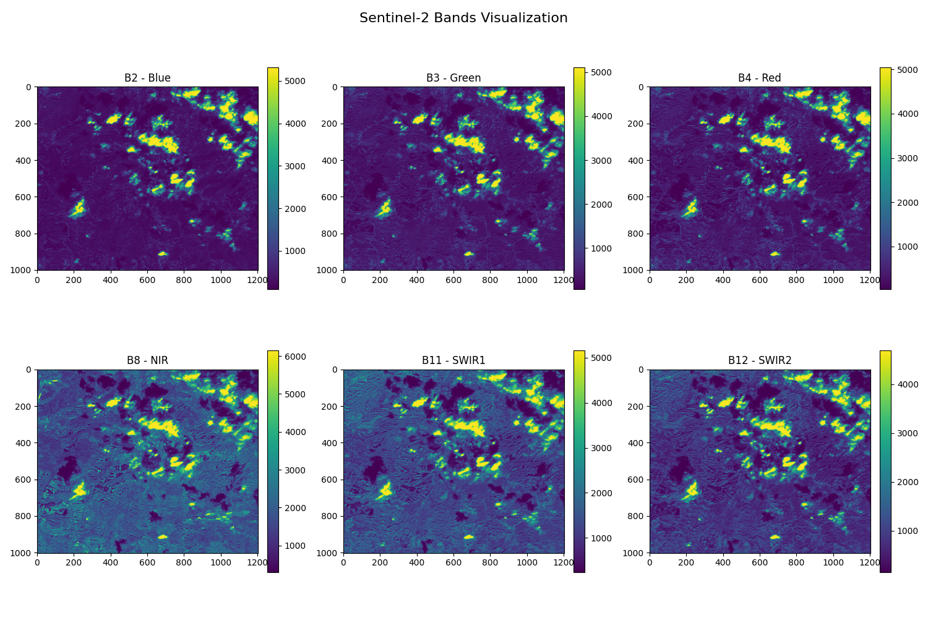
Satellite Image Processing (CNN)
• Use MobileNetV3 for extracting fire-relevant features.
• Focus on SWIR and NIR bands for fire detection.
• Output: Feature embeddings for fusion.

Slide 16
Weather & Terrain Processing (MLP/Transformer)
Transform weather and terrain data into feature embeddings.
Use a Transformer or MLP model for feature extraction.
Output: Encoded vectors for fusion.

Slide 17
Cross-Modal Fusion (Transformer)
Use attention-based fusion to dynamically weigh modalities.
Example: Prioritize SWIR in dry conditions.
Output: Final fire/smoke prediction.

Slide 18
Explainability (Grad-CAM & Attention Weights)
Grad-CAM highlights fire-relevant regions in satellite images.
Attention weights show weather/terrain contributions.
Helps interpret model decisions.

Slide 19
Model Training & Evaluation
Train using a combination of CNN, Transformer, and MLP.
Evaluate with accuracy, precision, recall, and F1-score.
Compare performance with baseline models.

Slide 20
Challenges & Solutions
Data alignment across different resolutions.
Handling class imbalance (fire vs. non-fire).
Model interpretability using explainability methods.

Slide 21
Future Work
Extend to real-time fire monitoring.
Improve generalization for different regions.

